Slide 1
NMAA Youth Education Initiatives: Acequia Culture Youth Leadership, Sembrando
Semillas, and Acequia Career Series Program
New Mexico Acequia Association

Slide 2
NMAA Youth Education Team
Paula García – Executive Director Serafina Lombardi – Director of Programs
Emily Arasim – Youth Education Coordinator & Acequia Program Assistant Donne Gonzales – Los Sembradores Farm Training Program Coordinator Amanda López – Sembrando Semillas Coordinator & Food and Seed Programs Coordinator Toribio Garcia – Acequia Education Coordinator David F. García - Acequia Outreach and Education Coordinator Chavela Trujillo – Acequia Mapping Specialist & Acequia Program Assistant

Slide 3
NMAA Youth Education Initiatives
Sembrando Semillas Youth Project
Los Sembradores Farmer Training Program
School/Classroom Presentations
Acequia Culture Youth Leadership Institute
Acequia Career & Lifeways Program
Acequia and Land Grant Education (ALGE)

Slide 10
Acequia Career & Lifeways Program

Slide 11
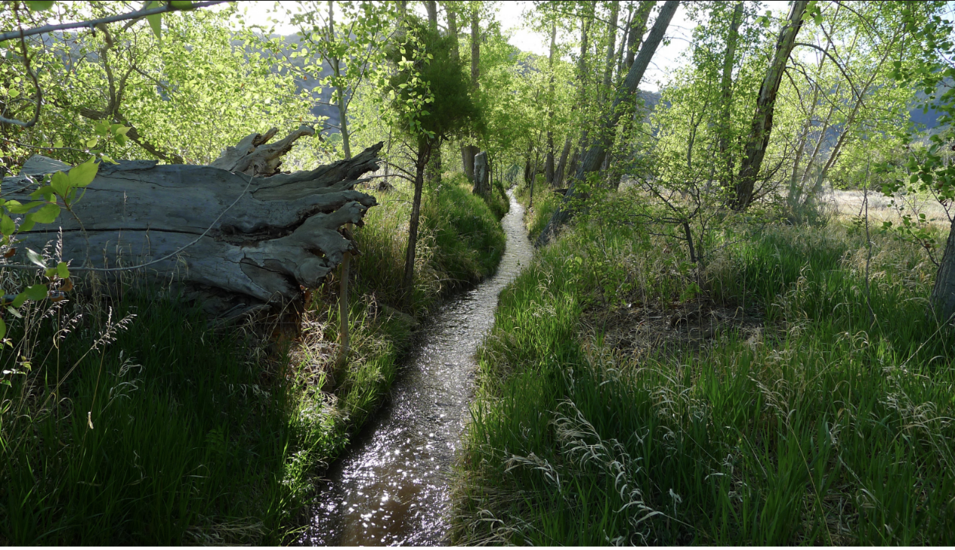
Acequia and Land Grant Education (ALGE)

Slide 13
¡A la escuela y a la acequia! ¡Que vivan las acequias!

