Slide 1
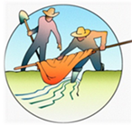
The Acequia Community – Colorado’s First Settlements
Grades K-2
Picture and Map Library
This library allows teacher to show the visual resources in this lesson using their overhead projector.

Slide 2
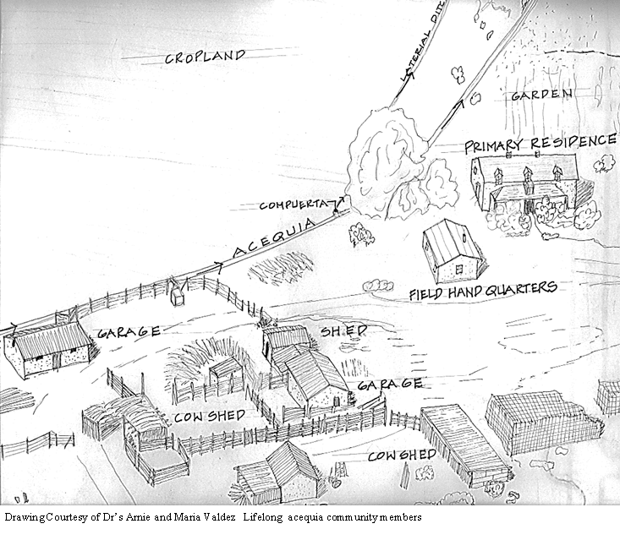

Slide 3
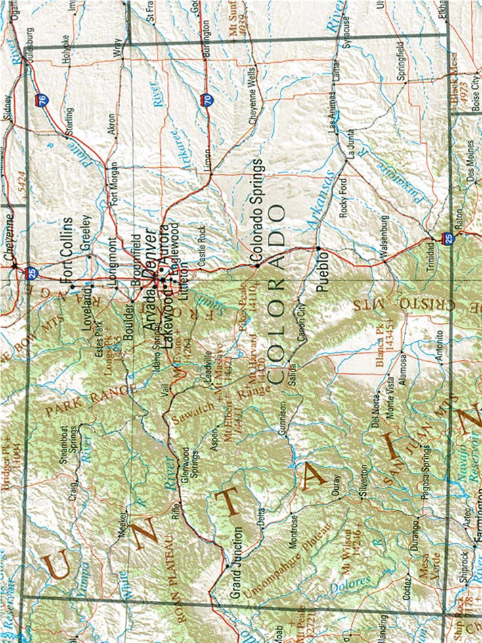

Slide 4
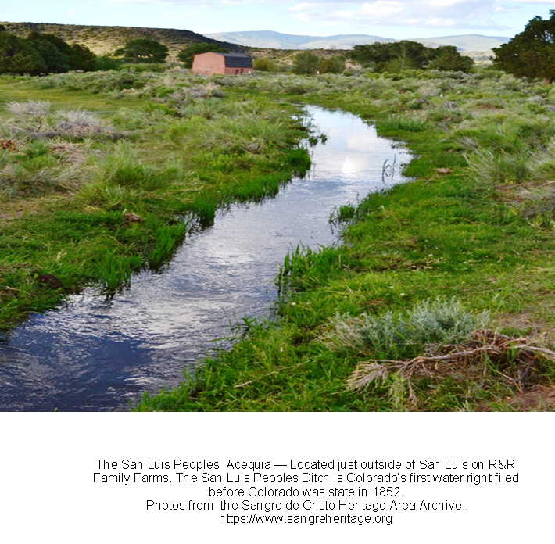

Slide 5
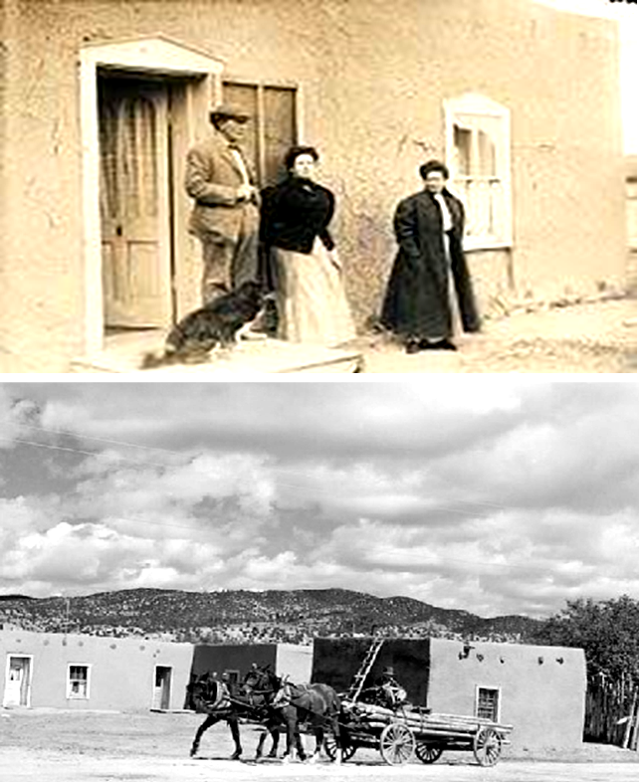
An original adobe homestead located in the acequia village of San Pablo.
Photos from the Sangre de Cristo Heritage Area Archive.
https://www.sangreheritage.org

Slide 6
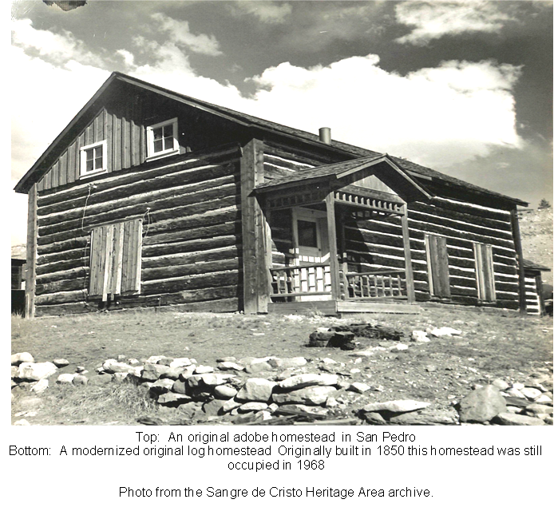

Slide 7
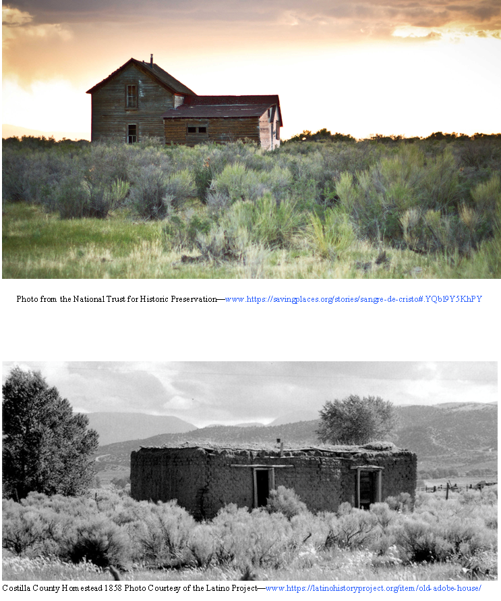

Slide 8
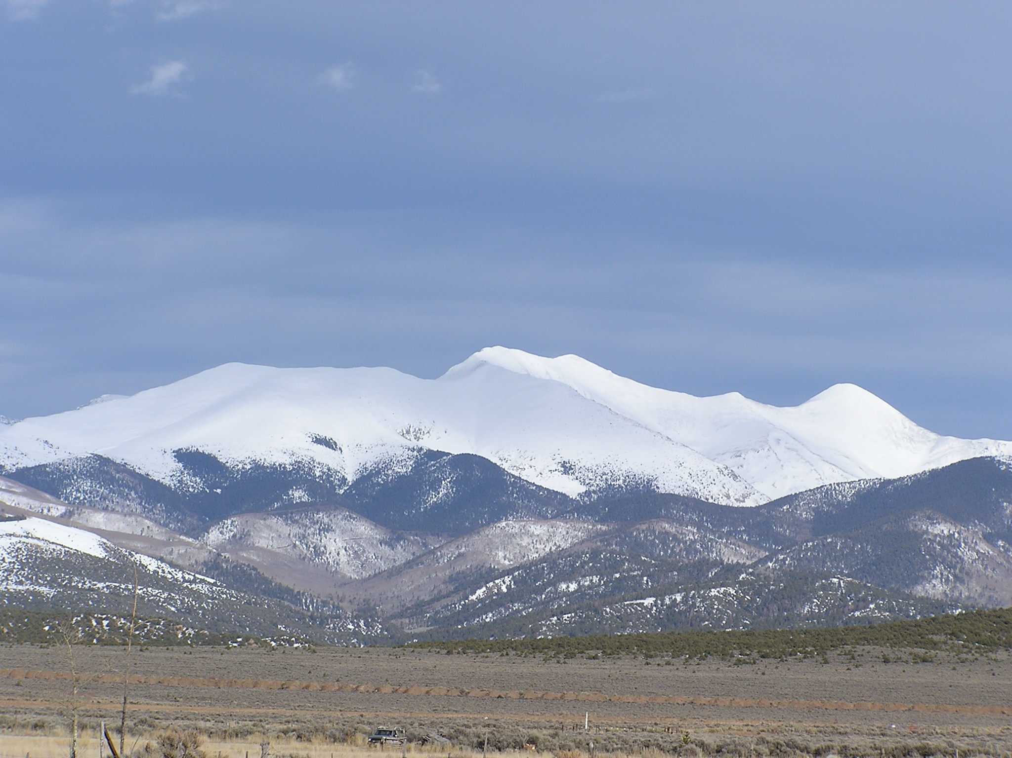
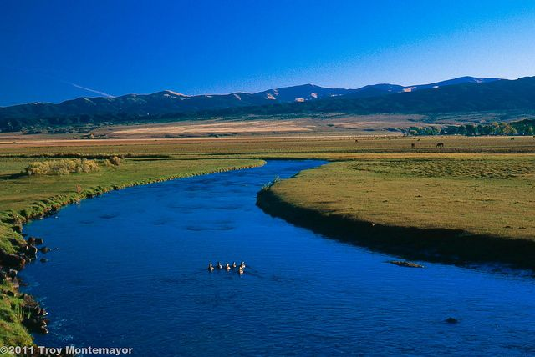
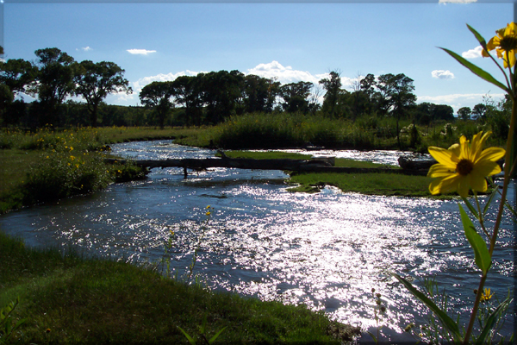
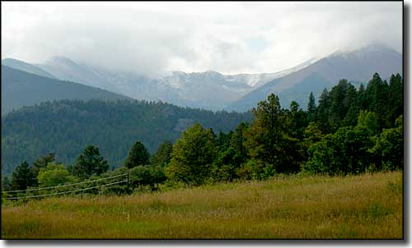
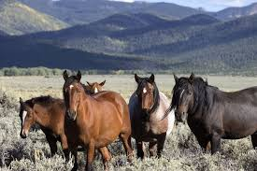
Scenes from the Sangre de Cristo Land Grant
Photos: Courtesy of www.istockphotos.com

