Slide 1
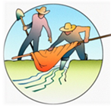
The Acequia Community – Colorado’s First Settlements
Grades 6-8
Picture and Map Library
This library allows teacher to show the visual resources in this lesson using their overhead projector.

Slide 2
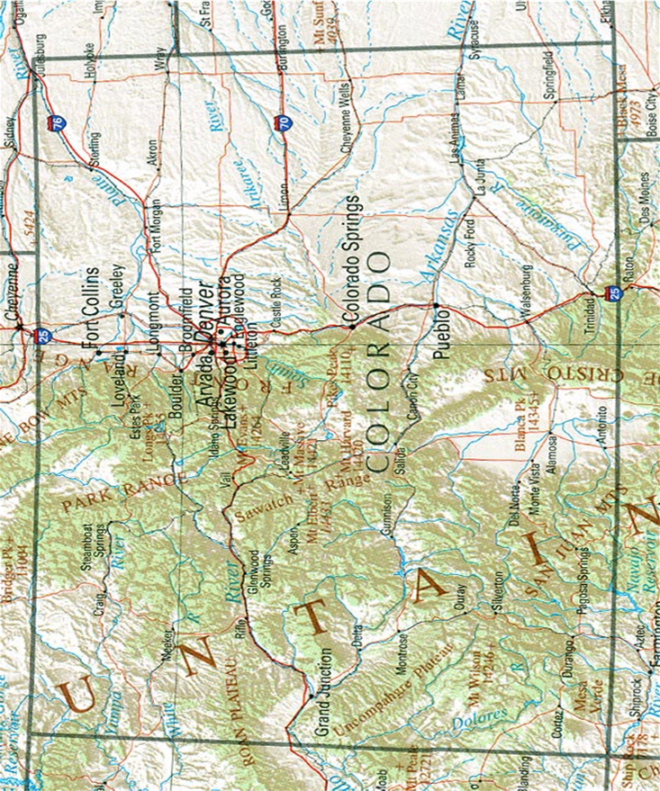

Slide 3
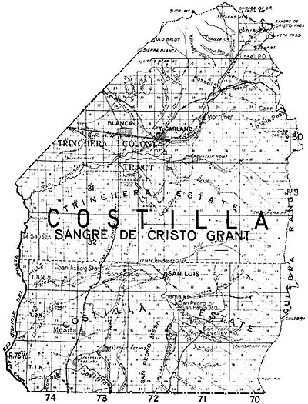
Photo courtesy of https://adamjamesjones.com/2012/05/29/charles-don-carlos-beaubien-trader-judge-pioneer/

Slide 4
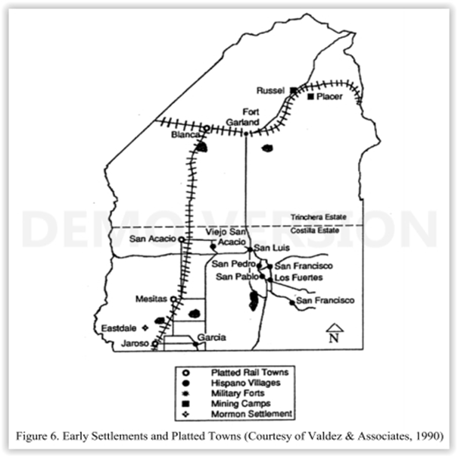

Slide 6
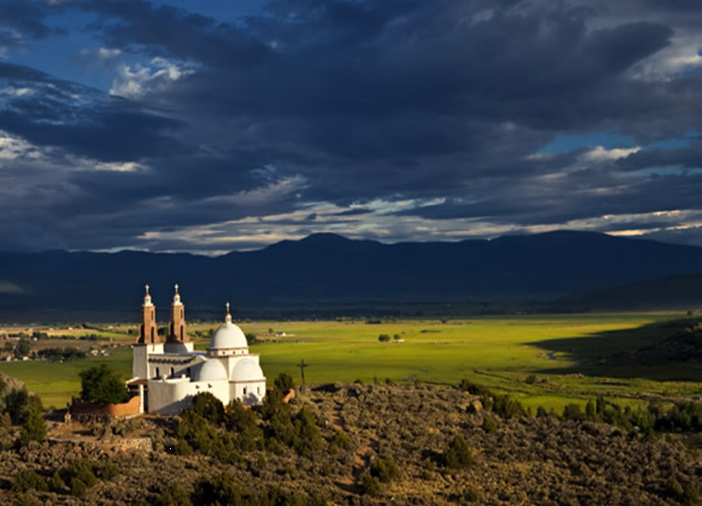

Slide 7
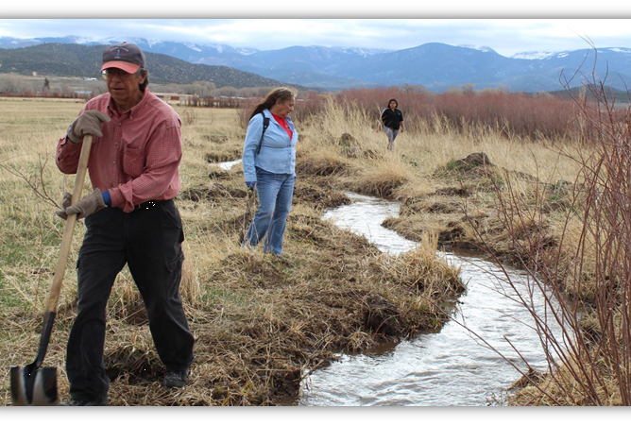
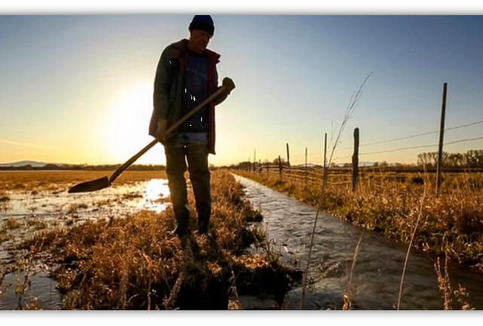
Maintenance of the acequia system is an intensive process, which requires everybody in the community to pitch in.
Luke Runyon—History Colorado https://www.historycolorado.org/Acequias-of-Southern-Colorado

