Slide 1
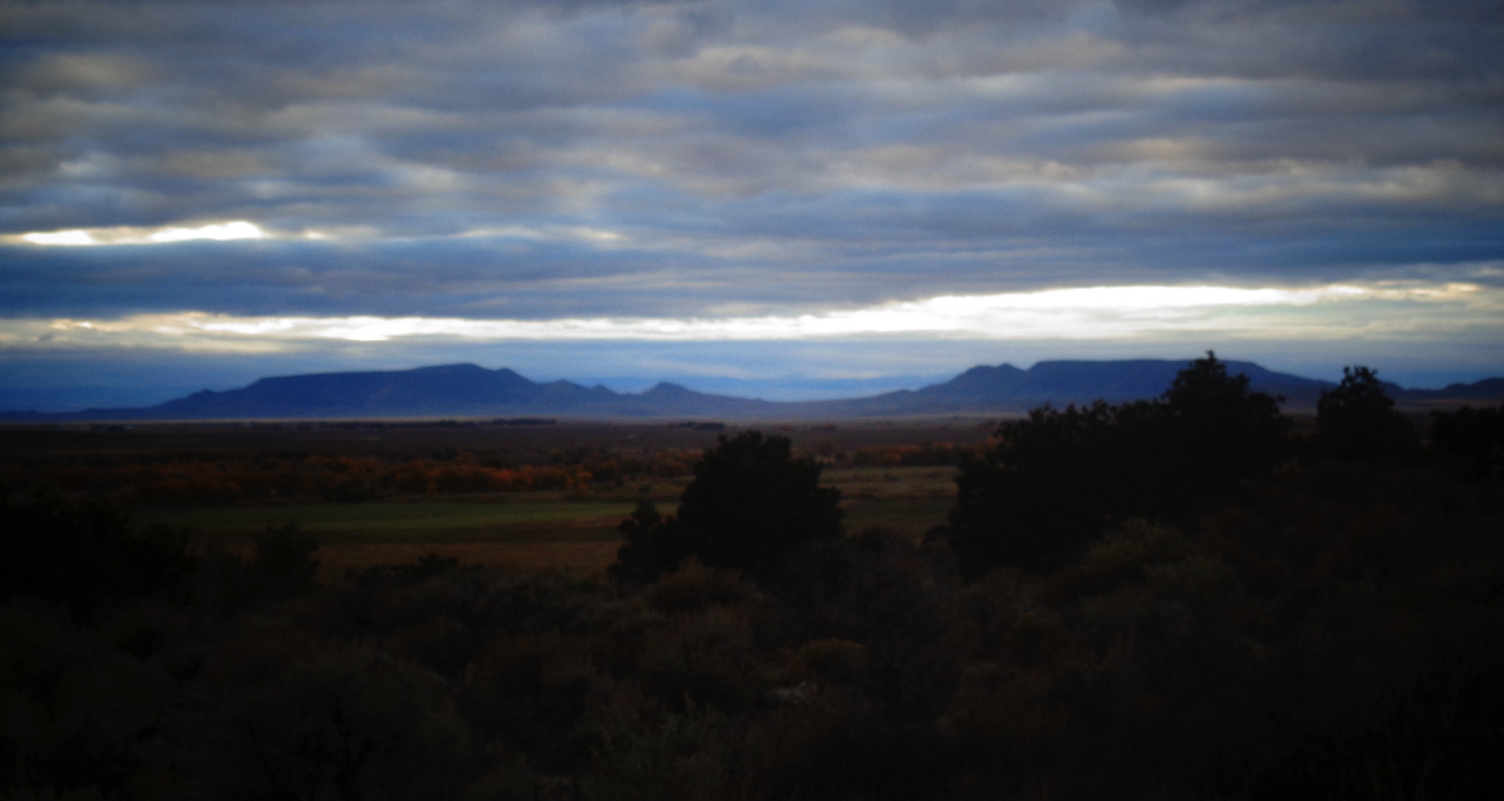
Acequia Bylaws and Incorporation
Acequia Assistance Project, University of Colorado Law School
Megan Gutwein, Class of 2016
Sarah Krakoff, Faculty

Slide 2
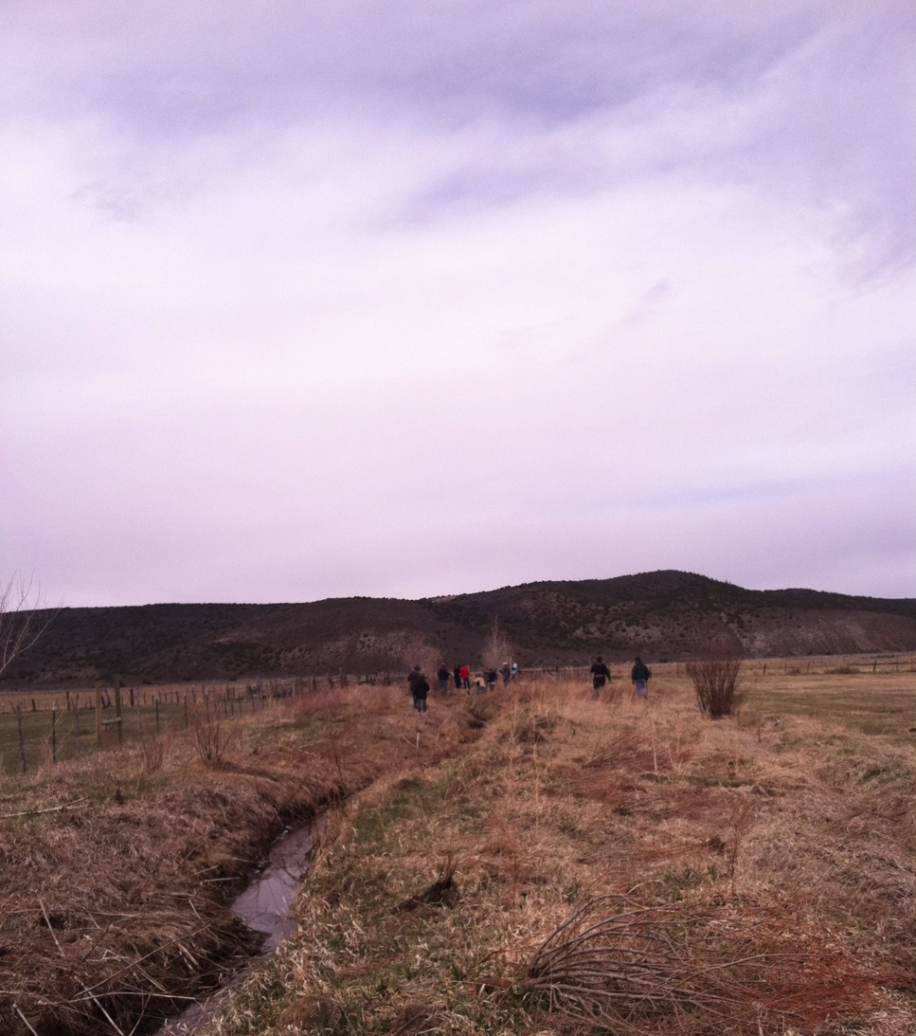
Acequia Recognition Statutes
In 2009 CO passed the Acequia Recognition Statute
  CRS § 7-42-101.5
  Amended 2013
Recognizes acequias as longstanding irrigation ditches with their own rules about governance and water allocation

Slide 3
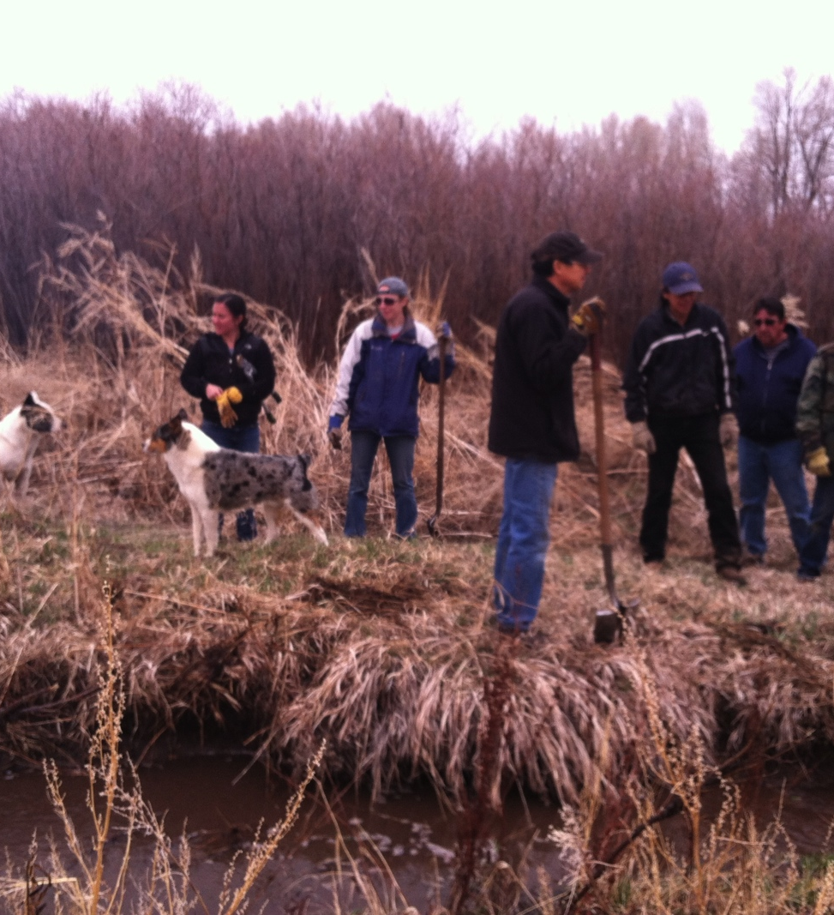
Acequia Statutes
Acequia Definition
  Originated before CO was a state
  Treated water as community resource
  Gravity-fed water system
  One landowner – one vote
  Parciantes provide labor for ditch maintenance
To benefit from the statutes, an acequia must either:
  Incorporate or
  Pass by-laws in accordance with the statutes

Slide 4
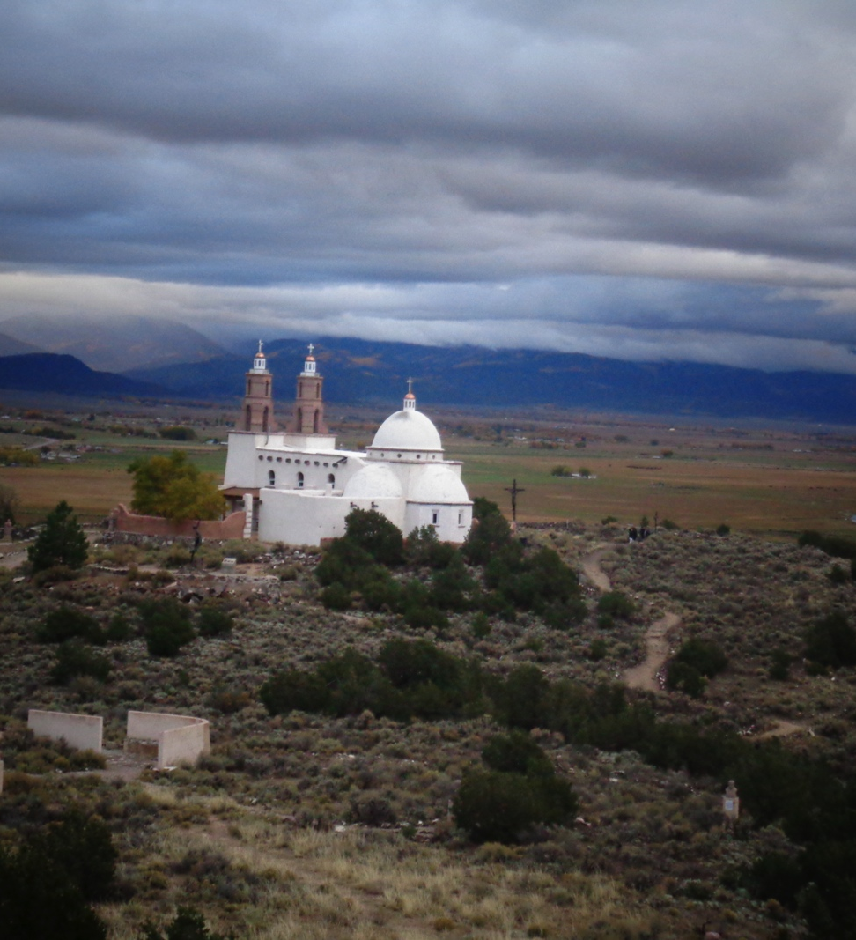
Benefits of Bylaws
Colorado law will recognize:
One landowner – one vote system
Parciantes can be required to contribute labor or a fee
Water can be allocated on a more communal basis
Right of first refusal regarding sale, lease, or exchange of water
Option to Impose Requirements on Sale or Transfer (Catlin Bylaw)
  Makes it harder to take water out of the acequia

Slide 5
Voting Bylaw Example
Option 1: Each member shall have one vote. For voting purposes, each household (or parcel of land co-owned by more than one person) constitutes one membership, regardless of the number of separate properties owned.
Option 2: A member's vote shall be in proportion to his/her shares.

Slide 6
Right of First Refusal Example
If the Acequia approves the request, and if the Parciante who wants to make a change in water right is attempting to sell, trade, or exchange that water right, the Parciante must first offer the water right to the Acequia on the same price, terms, and conditions as those being offered to any other party.

Slide 7
Catlin Bylaw Example
For water sales, transfers, or changes in water right
Parciante must consult Commission and verify that sale, transfer, or change will not injure others
Engineering report required
  Costs paid by the parciante who wants the change
If Acequia approves request, it can file a statement of opposition in water court in the interest of other Parciantes

Slide 8
Catlin Bylaw Example (cont.)
Parciante requesting a change has to pay the Acequia’s legal and engineering fees for water court
Parciante must first offer the water right to the Acequia at the same price as to other parties

Slide 9
Benefits of Bylaws
Unincorporated acequia associations are recognized as unincorporated nonprofit associations
  Therefore acequias have same basic protections as acequia ditch corporations
Provides a written set of rules for everyone, including newcomers, to follow, without changing traditional norms and customs
Brings Parciantes together to talk about and solve problems

Slide 10
Incorporation
Requirements to incorporate under Colorado Law
  Decide what corporate form (usually non-profit corporation)
  Amend by-laws to include any additional requirements
    For example, to state a non-profit purpose; to include a dissolution plan
  Draft articles of incorporation according to legal requirements
  File papers with the Secretary of State and pay fee of $50.00

Slide 11
Why incorporate?
Most acequias will have all the protections they need by adopting by-laws that take advantage of the powers recognized in the Acequia Recognition Statute
Some acequias may want the additional formality of being incorporated.
  Third parties (banks, foundations, government granting agencies) may be more comfortable dealing with a corporate entity than an unincorporated association
    Some granting entities do not consider unincorporated associations to be appropriate fiscal agents
  Otherwise, most legal protections are the same

